Slide 1

Predicting Overall Survival for Patients with Metastatic Castration-Resistant Prostate Cancer
Belal Elsiesy, Guanghua Xiao, Ph.D.
Department, UT Southwestern Medical Center, Dallas, Texas

Slide 2
Introduction
Prostate cancer (PCa) – 2nd most common cancer among men [2]
14.1% of new cancer cases
6.8% of mortalities
Castration resistant prostate cancer (CPRC) – advanced stage of PCa
Resistant to andogen-deprivation therapy and other treatments
Prognostic factors:
Eastern Cooperative Oncology Group(ECOG) patient performance status
bone pain
prostate-specific antigen(PSA) levels
Testosterone levels
alkaline phosphatase(ALP) levels
Prognostic model
2014 model: confirm known predictive factors and add:
Disease site
Lactate dehydrogenase (LDH)
Opioid analgesic use
Albumin (ALB)
Hemoglobin(HB)
New model
Data from phase 3 clinical trials, released by Project Data Sphere
Goal 1: identify prognostic factors in data (new and known)
Goal 2: accurately predict patient risk

Slide 3
Materials and Methods
Traditional Machine Learning Models for Prediction:
Each model ran with target as binary risk variable and 10-fold cross validation
Support Vector Machine (adjust C and gamma parameters based on Grid Search)
Logistic Regression
Random forest model (adjust # of estimators in forest)
Artificial Neural Network:
Create Model: 101 > [101 > 50] > 1
Run for different # of epochs (100 vs 350)
Scale data to normal distribution
Create less complex model: 101 > [50 > 25] > 1, run for 350 epochs with scaled data
Survival Analysis:
Choose best performing model based on accuracy
Train on entire training set and predict risk group for independent testing set
Plot Kaplan Meier curves for that set with model predicted groups
Run Log-rank test to analyze results
Plot Variable importance to reveal most important factors
Data: The patient data is from Project Data Sphere and is publicly available.
Calculating Risk:
Binary Variable
Low: survived >2years
High: died in <1year
Other patients: dropped from dataset
Univariate Analysis for Binary Variables:
Contingency tables between variable and risk variable
Chi-squared test on table
Fisher’s exact test on table
Filter by p < ~0.05/101 (Bonferroni Correction)
Univariate Analysis for Continuous Variables:
Box plots comparing distribution of variable and risk
T-tests between risk groups
Filter by p < ~0.05/101 (Bonferroni Correction)

Slide 4
Results

Slide 5
Dataset General Information
Variable | Training Set | Testing Set
# of Patients | 470 | 476
Mean Survival Time | 648 | 372.5
Age
18-64 | 159 | 111
65-74 | 212 | 211
75+ | 99 | 154
ECOG Status
Fully Active | 223 | 220
Restricted Activity | 247 | 256
Status
Alive | 158 | 338
Dead | 312 | 138

Slide 6
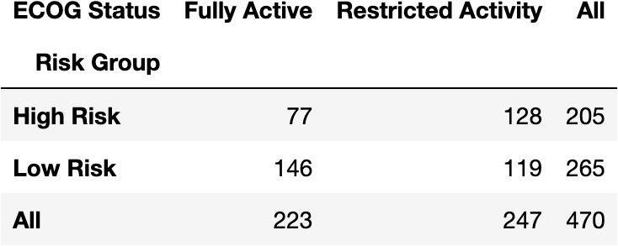
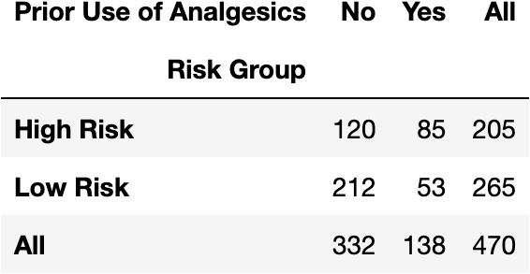
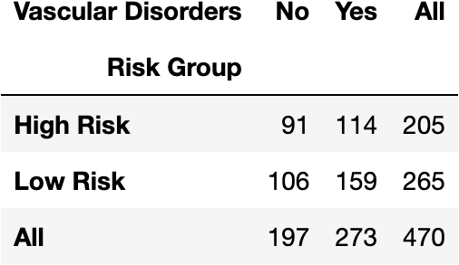
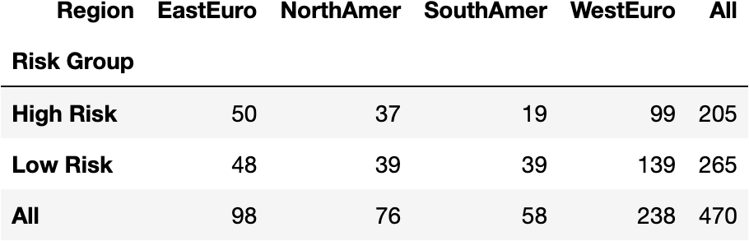
Binary /
Categorical variables
(p < 0.0005)

Slide 7
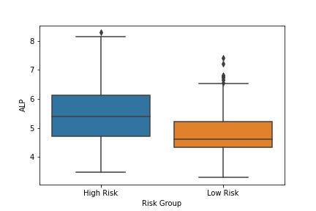
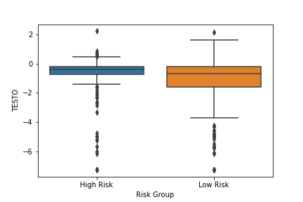
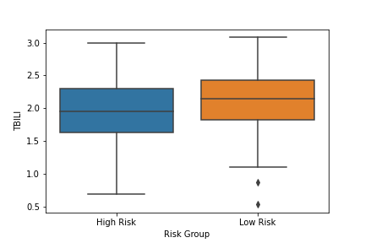
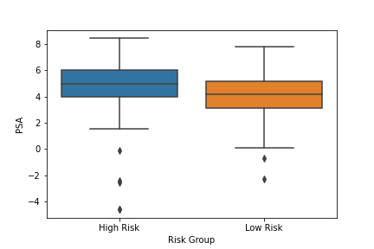
Continuous variables (p < 0.0005)
Testosterone
Alkaline
Phosphatase
Total Bilirubin
Prostate Specific Antigen

Slide 8
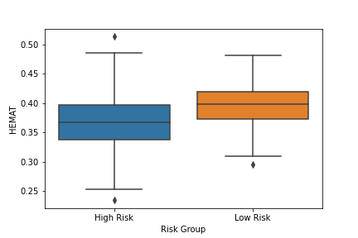
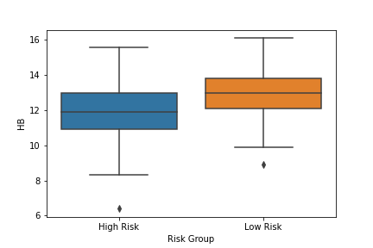
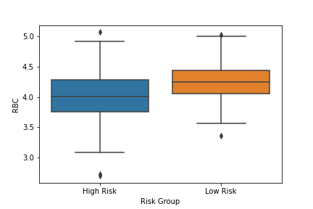
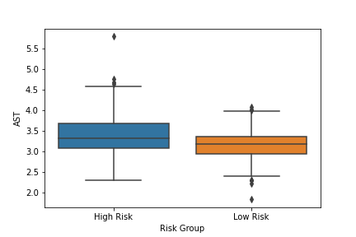
Continuous variables (p < 0.0005)
Hemoglobin
Hematocrit
Red Blood Cells
Aspartate Aminotransferase

Slide 9
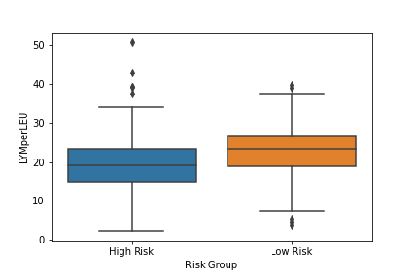
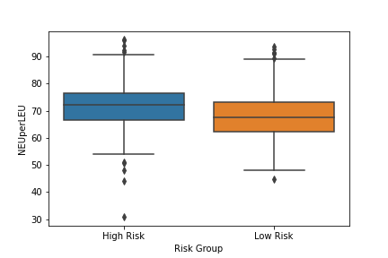
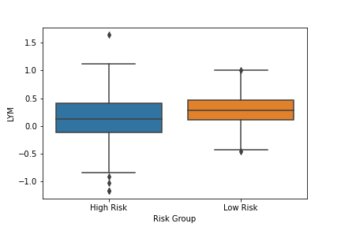
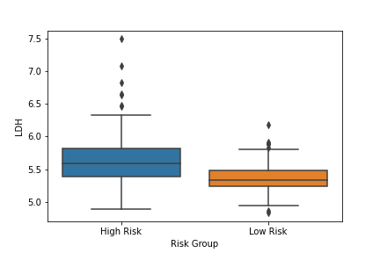
Continuous variables (p < 0.0005)
Neutrophil to leucocyte ratio
Lymphocyte to leucocyte ratio
Lymphocytes
Lactate
Dehydrogenase

Slide 10
Model Prediction Accuracy
Model | Prediction Accuracy (std)
Support Vector Machine (Default Parameters) | 63.36% (0.94%)
Support Vector Machine (Best Parameters: 'C': 10, 'gamma': 0.0001) | 71.31% (3.51%)
Logistic Regression | 79.66% (5.41%)
Random Forest (n estimators = 100) | 81.05% (7.44%)
Random Forest (n estimators = 300) | 81.45% (5.64%)
Artificial Neural Network (epochs=100) | 67.02% (9.19%)
Artificial Neural Network (epochs=350) | 69.15% (6.68%)
Artificial Neural Network (epochs=350, scaled data) | 72.55% (4.09%)
Artificial Neural Network (epochs = 350, scaled data, less complex model) | 72.13% (4.70%)

Slide 11
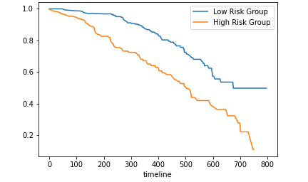
Survival Analysis for Predicted Risk Groups from Random Forest Model (Independent Testing Set)
Log Rank Test Results
p: 1.551e-07
test statistic: 27.525

Slide 12
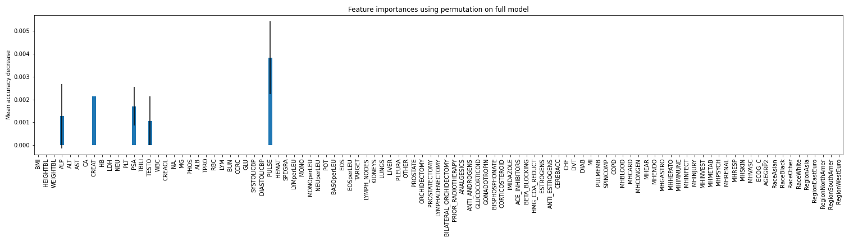
Random Forest Model Feature Importance

Slide 13
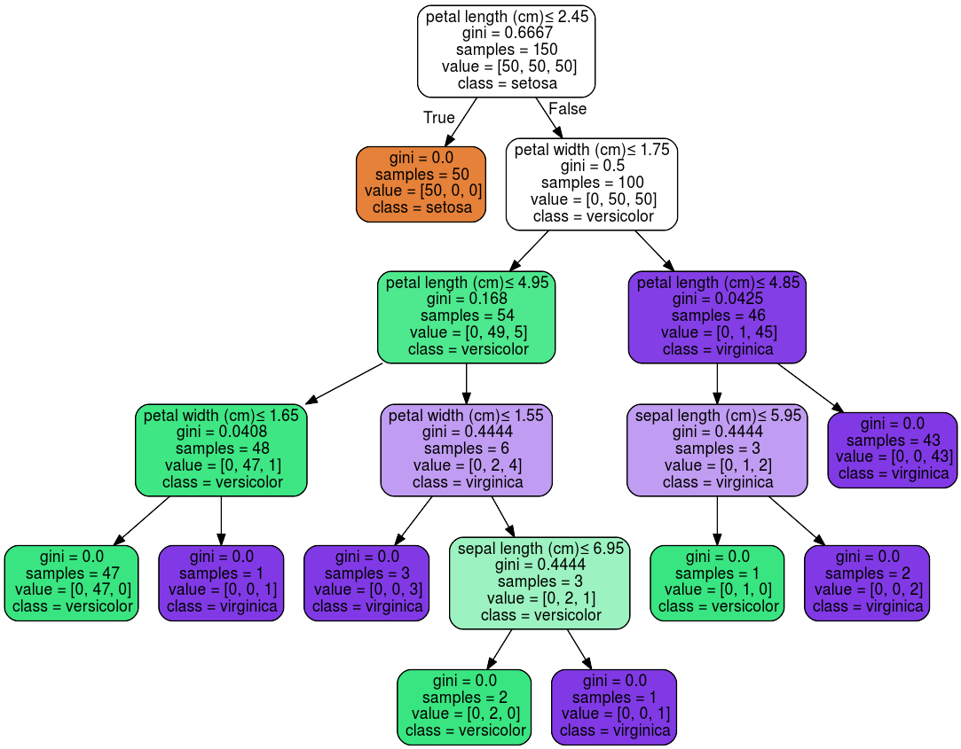
Random Forests
Decision tree
Classification
Split on nodes based on:
Entropy - uncertainty
Information Gain
Random Forest
Group of decision trees
Sample data
Different weights for different splits
Classify based on most ‘votes’
Notes:
Ex: If 80% of patients with ECOG status 1 (Restricted Activity) are high risk, we are 20% uncertain
Ex: If 50% of patients with diabetes are high risk, we are 50% uncertain and gain little information from that split

Slide 14
Conclusions
Prognostic Factors(p < 0.0005; based on Bonferroni correction)
Confirm previously known variables:
Regular Testing: ALP, PSA, TESTO
2014 Model: ECOG, disease site, analgesics, LDH, ALB, HB, PSA, ALP
New Predictors (Confirmed by other analysis of same dataset^{)[1]}:
Immune/Lymphatic system (Lymphocyte to leucocyte ratio, Lymphocyte, Neutrophil to leucocyte ratio)
Kidney function (total bilirubin , Creatinine)
Vascular system and hematology (Hemoglobin, Red Blood Cells, Hematocrit)
Aspartate Aminotransferase, Lactate Dehydrogenase, Region
Model Performance
Random Forest Classifier performed best
Ensemble model → Prevent overfitting to data, unlike others
Clear predictive features (PSA, TESTO, ALP) + CREAT → trees split on them (high information gain), as shown in variable importance plot
Artificial Neural Network (ANN) performed the worst
ANNs work well will large amounts of data, not small amounts

Slide 15
Future Directions
Utilize new understanding of risk factors for diagnosis and prognosis
Incorporate genomics data and pathology imaging into model given current research advances
Develop similar prognostic models for other types of cancer

Slide 16
Literature Cited
Guinney, J., Wang, T., Laajala, T. D., Winner, K. K., Bare, J. C., Neto, E. C., Khan, S. A., Peddinti, G., Airola, A., Pahikkala, T., Mirtti, T., Yu, T., Bot, B. M., Shen, L., Abdallah, K., Norman, T., Friend, S., Stolovitzky, G., Soule, H., Sweeney, C. J., … Prostate Cancer Challenge DREAM Community (2017). Prediction of overall survival for patients with metastatic castration-resistant prostate cancer: development of a prognostic model through a crowdsourced challenge with open clinical trial data. The Lancet. Oncology, 18(1), 132–142. https://doi.org/10.1016/S1470-2045(16)30560-5
Sung, H, Ferlay, J, Siegel, RL, Laversanne, M, Soerjomataram, I, Jemal, A, Bray, F. Global cancer statistics 2020: GLOBOCAN estimates of incidence and mortality worldwide for 36 cancers in 185 countries. CA Cancer J Clin. 2021: 71: 209- 249. https://doi.org/10.3322/caac.21660
Hotte, S. J., & Saad, F. (2010). Current management of castrate-resistant prostate cancer. Current oncology (Toronto, Ont.), 17 Suppl 2(Suppl 2), S72–S79. https://doi.org/10.3747/co.v17i0.718
Halabi, S., Lin, C. Y., Kelly, W. K., Fizazi, K. S., Moul, J. W., Kaplan, E. B., Morris, M. J., & Small, E. J. (2014). Updated prognostic model for predicting overall survival in first-line chemotherapy for patients with metastatic castration-resistant prostate cancer. Journal of clinical oncology : official journal of the American Society of Clinical Oncology, 32(7), 671–677. https://doi.org/10.1200/JCO.2013.52.3696
scikit-learn developers. (2020). Iris. scikit-learn. https://scikit-learn.org/stable/_images/iris.png. s

Slide 17
Acknowledgements
I would like to first express my gratitude to the wonderful STARS program staff of Dr. Joel Goodman, Lynn Tam, Maria Sandlin, Mary Leyendecker, Pearlie Crawford, and Kristie Conner for this great opportunity. Your work organizing and managing the events, seminars, and meetings didn’t go unnoticed, and I appreciate your availability and help during this virtual program.
I would also like to acknowledge Dr. Guanghua Xiao and Dr. Yang Xie for the opportunity to intern with and learn from them. I appreciate all the guidance and help from you, and all the techniques and analyses I’ve learned during this project. I look forward to continuing work with you both on the pediatric cancer awareness website and potentially returning in future summers.

